Slide 1

Semi-Annual Commercial Real Estate Overview

Slide 2

Commercial Real Estate Lending – TRENDS
Non Owner Occupied Commercial Real Estate originations down significantly in 2023 (Total $ originated down 38% vs. 2022)
Interest rates
Construction costs
Pending Fed rate decreases
Economic uncertainty
BCSB investment commercial real estate concentrations continue to be lower than peers
Allows for growth in investment commercial real estate and construction loans while still staying below FDIC definition of real estate concentration
As of 12/31/24 UPBR report, BCSB ICRE/Tier 1 Capital Ratio was 140.82% vs. peer average of 188.87%
Overall credit quality remains satisfactory as evidenced by portfolio delinquency rates, weighted average risk ratings and results of Cobblestone 2024 stress test as compared to peers (BCSB 57 bp Tier 1 capital impact vs. 76 bp peer average)

Slide 3
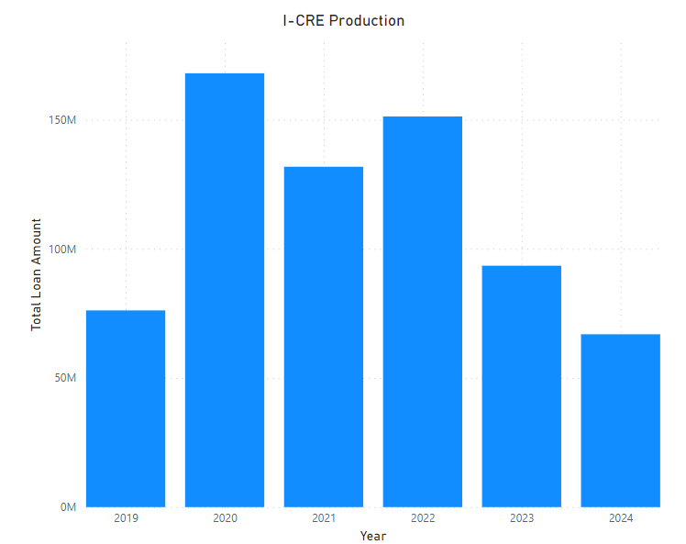
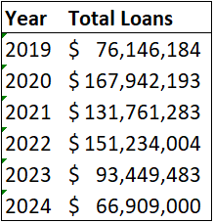
Production (Investment-Commercial Real Estate)

Slide 4
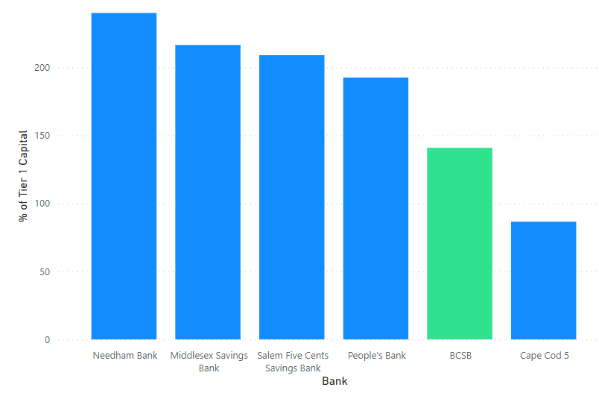
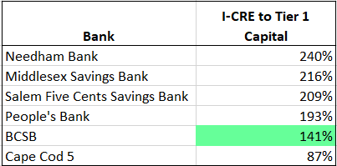
Non-Owner Occ as a % of Common Equity Tier 1 Capital
FFIEC Call Report Data 2022 – 2024 (Q1)
Description
Non-owner OCC Commercial Real Estate, % of Tier 1 Capital plus Allowance for Credit Losses on Loans and Leases
Narrative
The sum of construction & land development loans, multifamily property loans, non-owner occupied non-farm non-residential property loans and loans to finance CRE not secured by real estate divided by Tier 1 Capital plus allowance for credit losses on loans and leases
Source: FFIEC.gov/Public/Reports/
Notes:
Important to note that NOO according to the FFIEC includes Construction in the Non-Owner Occ to Tier 1 Capital calculation
Separate and against peers
Paul’s KRI
Two separate slides

Slide 5
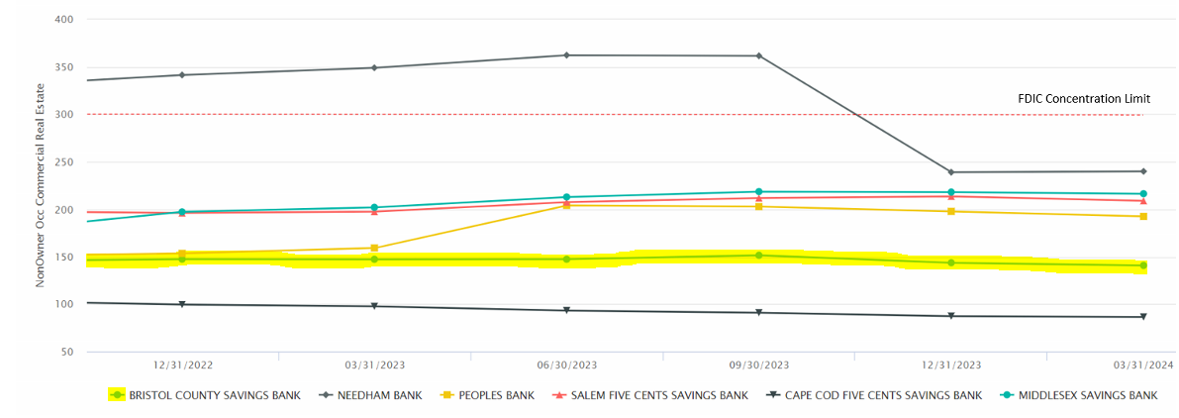
Non-Owner Occ as a % of Common Equity Tier 1 Capital
FFIEC Call Report Data 2022 – 2024 (Q1)
Description
Non-owner OCC Commercial Real Estate, % of Tier 1 Capital plus Allowance for Credit Losses on Loans and Leases
Narrative
The sum of construction & land development loans, multifamily property loans, non-owner occupied non-farm non-residential property loans and loans to finance CRE not secured by real estate divided by Tier 1 Capital plus allowance for credit losses on loans and leases
Source: FFIEC.gov/Public/Reports/
Notes:
Important to note that NOO according to the FFIEC includes Construction in the Non-Owner Occ to Tier 1 Capital calculation
Separate and against peers
Paul’s KRI
Two separate slides

Slide 6
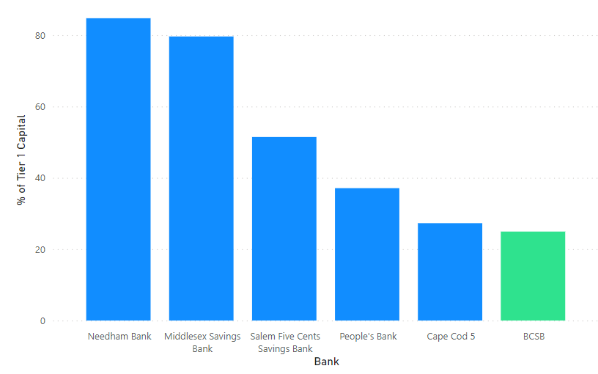
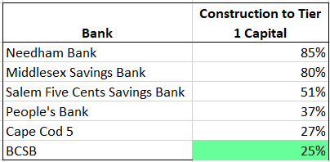
Construction as a % of Common Equity Tier 1 Capital
FFIEC Call Report Data 2022 – 2024 (Q1)
Description
Construction & Development Loans, % Tier 1 Capital plus Allowance
Narrative
Construction, land development and other land loans divided by Tier 1 Capital plus Allowance
Source: FFIEC.gov/Public/Reports/
Notes:
Important to note that NOO according to the FFIEC includes Construction in the Non-Owner Occ to Tier 1 Capital calculation
Separate and against peers
Paul’s KRI
Two separate slides

Slide 7
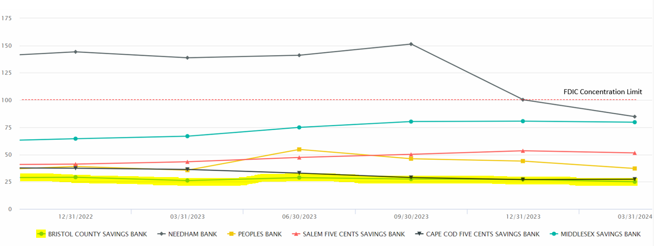
Construction as a % of Common Equity Tier 1 Capital
FFIEC Call Report Data 2022 – 2024 (Q1)
Description
Construction & Development Loans, % Tier 1 Capital plus Allowance
Narrative
Construction, land development and other land loans divided by Tier 1 Capital plus Allowance
Source: FFIEC.gov/Public/Reports/
Notes:
Important to note that NOO according to the FFIEC includes Construction in the Non-Owner Occ to Tier 1 Capital calculation
Separate and against peers
Paul’s KRI
Two separate slides

Slide 8
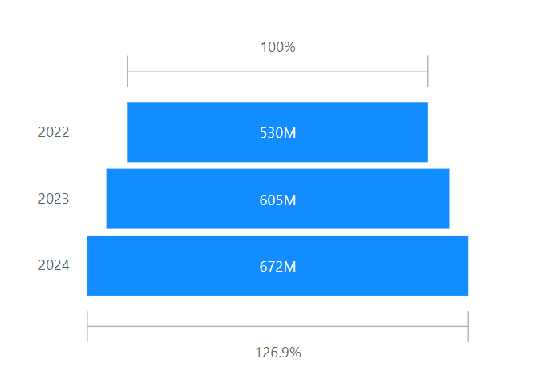
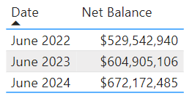
Non Owner Occupied Growth

Slide 9
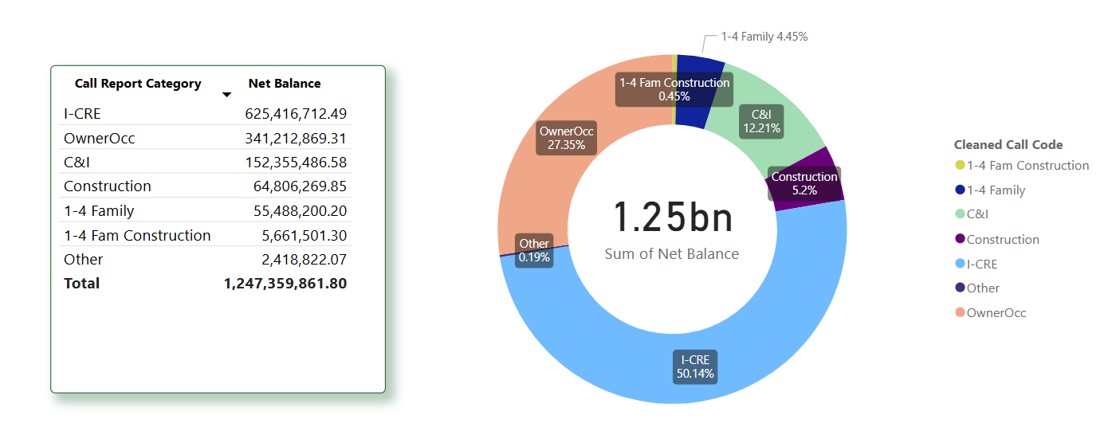
Total Commercial Portfolio
Notes:
Owner Occupied RE spell out
- Take a look at the ‘Other’

Slide 10
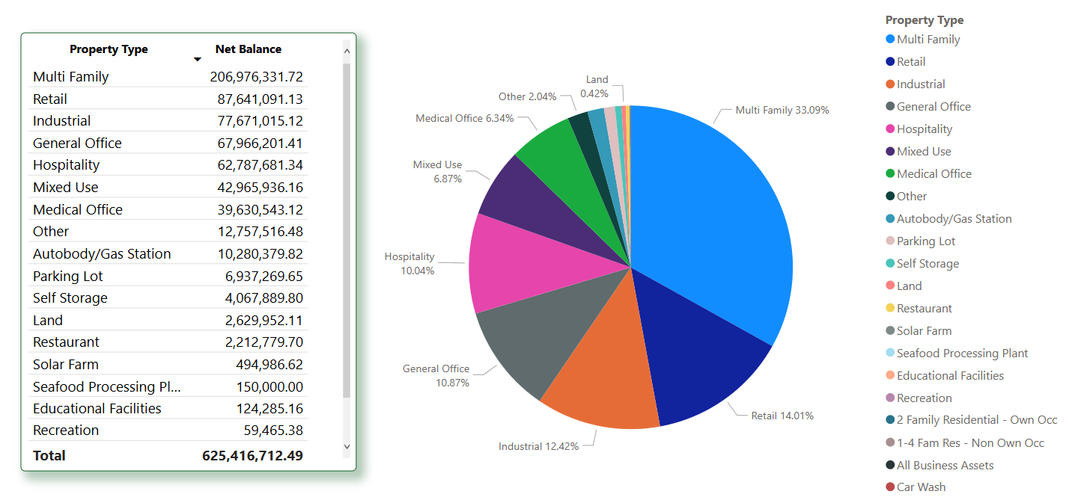
Investment-Commercial Real Estate Portfolio
Notes:
Excludes Construction

Slide 11

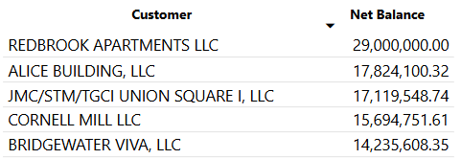
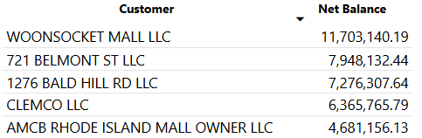
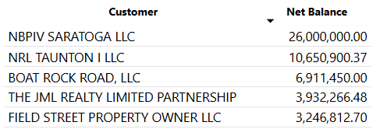
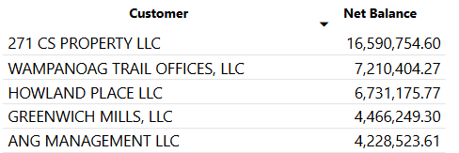
Investment-Commercial Real Estate Portfolio Top 5
Multi-Family
Retail
Industrial
General Office
Notes:
Risk rating add in

Slide 12
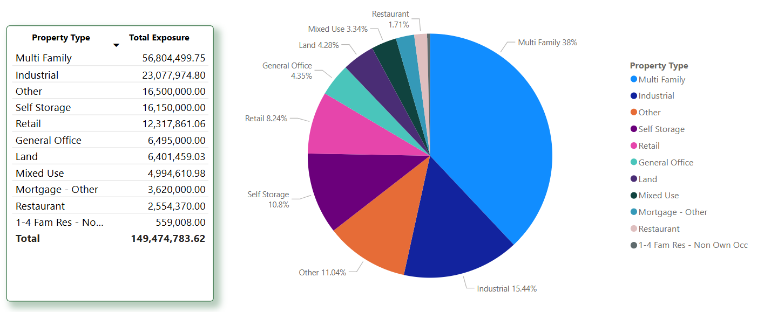
Construction Investment-Commercial Real Estate Portfolio
Notes:
Keep in mind: This is Credit Limit Amount (Balance + Available + Interest Reserve)
Difference between this value and the ‘Net Balance’ shown on CML Summary slide
Zeiterion Realty/Theatre are 79% of the Commercial – Other (Paskamansett is the other item in this category).

Slide 13

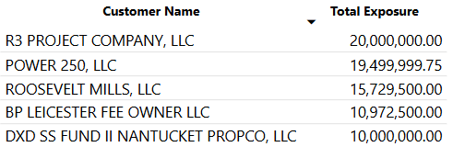
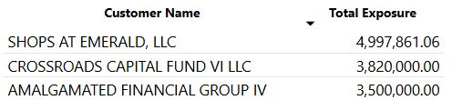
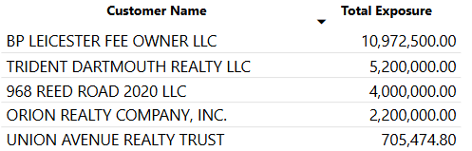
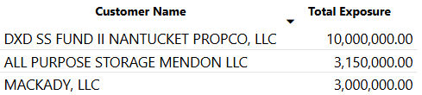
Construction Investment-Commercial Real Estate Portfolio Top 5
Multi-Family
Retail
Industrial
Self Storage
Notes:
- The main items in ‘Other’ are Zeiterion Theatre loans & Paskamansett

Slide 14
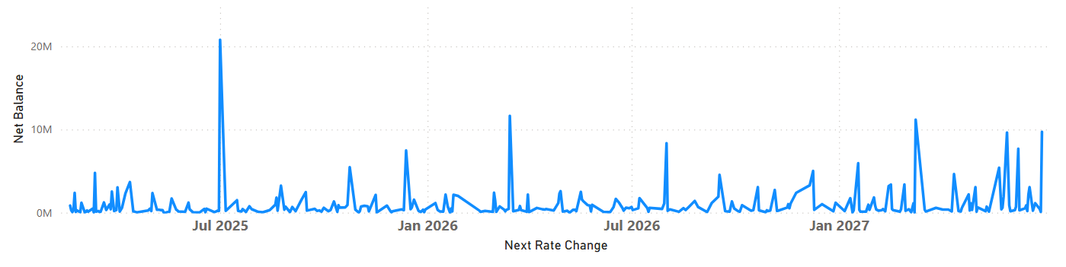
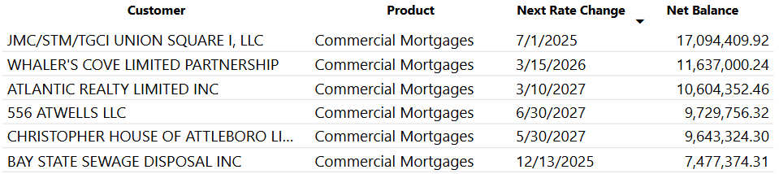
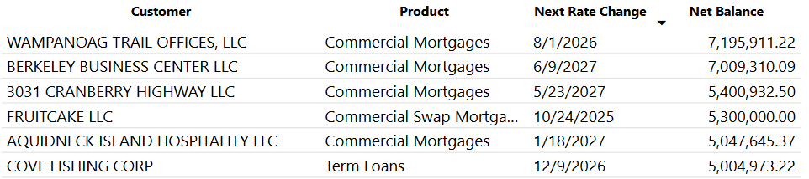
Commercial Lending Interest Rate Adjustments (excluding Swaps)
Notable Changes over the next 18 months:

Slide 15
Loans > $3MM with Interest Rate Resets through 2026
Bourne Real Estate Holdings: $7,586M, February 2025 (50% participated out to HarborOne)
100 key Hampton Inn hotel in Bourne, MA
49% LTV and 1.21x DSC in 2022; strong sponsor (David Darling)
Waterfront Hospitality: $5,002M, March, 2025
106 key Fairfield by Marriott located in New Bedford
47% LTV and 3x DSC
Route 6 Marketplace: $3,791M, April, 2025
52M SF strip plaza in Fairhaven
65% LTV, 1.63x DSC, strong sponsor (Mark White)
Innerbelt II QOZB: $5MM, August 2025 (BCSB portion of participation in)
2 story mill-style building containing 80 artist’s lofts in Somerville
37% LTV as is; strong sponsors (Leerink/Pachios)

Slide 16
Loans > $3MM with Interest Rate Resets through 2026 (continued)
Wampanoag Trail Offices, LLC, August, 2026
2 multi-tenant office buildings totaling 91M SF located in E. Providence
67% LTV and 1.69x DSC; strong sponsor (Saletin/Crecelius)
Hutchens Holding IV, LLC, September, 2026
98M SF cold storage facility located in New Bedford
71% LTV and 2.71x combined DSC (facility and facility operator; owner occupied property)
38 Pleasant Valley Pkwy, LLC, October, 2026
4,600 SF gas station/convenience store subleased to Irving Oil, located in Providence
63% LTV and 1.83x DSC
Lily M Fishing LLC, December, 2026
Lobster/scalloper fishing vessel operating out of New Bedford (owned by John Murray)
40% estimated LTV and 3.88x DSC
Cove Fishing Corp, December, 2026
Two lobster/scalloper fishing vessels operating out of New Bedford (owned by Lars Vinjerud)
69% LTV and 1.06x DSC

Slide 17
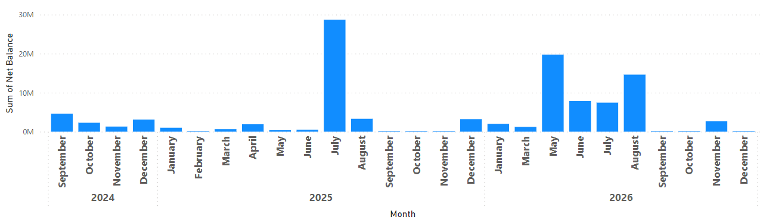
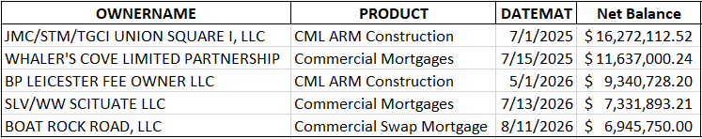
Maturing Commercial Loans Secured by Real Estate through 2026
Notable Mentions:

Slide 18
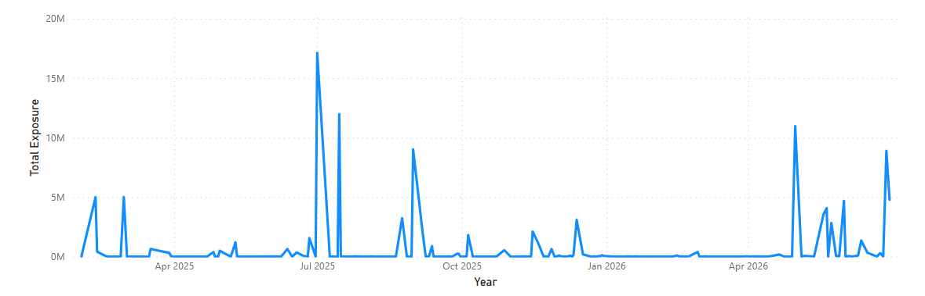
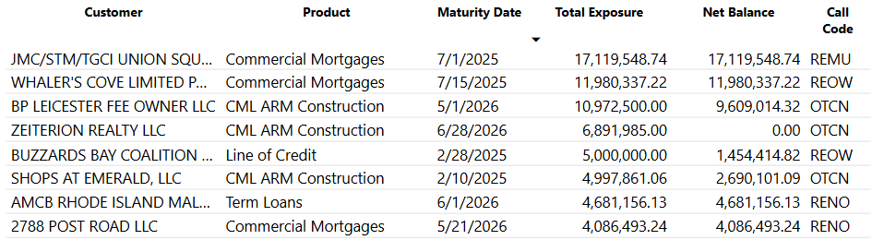
Maturing Commercial Loans Secured by Real Estate through 2026
Notable Mentions:

Slide 19
Largest Loans with Maturity Dates through 2026
JMC/STM/TGCI Union Square I: $16,272M, July 2025 (BCSB portion of participation in)
Construction of 153 apartment units in Somerville; Phase I complete and occupied, Phase II 95% complete.
61% LTV as complete; strong sponsor (John M. Corcoran & Co.)
Whaler’s Cove Limited Partnership: $11,980M, July 2025
120 unit assisted living facility servicing primarily low to moderate income clients, located in New Bedford
92% LTV, 0.5x DSC. “5” rated workout credit with weak sponsor. Loan is non-recourse to principal.
Upon foreclosure, low income restrictions are no longer in place and property value increases to $42.06MM (RE only)
BP Leicester Fee Owner LLC: $9,341M, May 2026 (BCSB portion of participation in)
Construction of a 267M SF Class A warehouse/distribution facility in Leicester
99% complete; 71% LTV as complete. Strong sponsor group (John M. Corcoran, Berkeley Partners).
SLV/WW Scituate LLC: $7,332M, July 2026 (BCSB portion of participation in)
60 unit apartment building in Scituate, MA (15 affordable units)
95% occupancy, 2.84x pro-forma DSC, 52% LTV
Boat Rock Road, LLC: $6,946M, August 2026
116M SF warehouse located in Mattapoisett, MA
68% LTV; in lease-up phase. Strong sponsor (Ricciardi).

Slide 20
Submarket Concentration – Non Owner Occupied Properties (Per CoStar)
Submarket | Total Commitment (in 000s) | % Tier 1 Capital | # Loans
Attleboro/New Bedford Retail | $51,856 | 11.39% | 42
Attleboro/New Bedford Office | $48,259 | 10.60% | 31
Northeastern Providence County Multi-Family | $38,326 | 8.41% | 35
South Plymouth County | $32,186 | 7.07% | 2
Attleboro/New Bedford Industrial | $27,052 | 5.94% | 21
Route 3 South Office | $26,624 | 5.84% | 5
E. Cambridge/Kendall Sq. Office | $22,639 | 4.97% | 4
495-South Multi-Family | $22,616 | 4.97% | 2
Fall River Multi-Family | $20,289 | 4.46% | 13
92 other submarkets | $407,413 | 89.5% | 266

Slide 21
Takeaways from Market Data
Generally, our markets with NOOCRE concentration have good fundamentals
Vacancy remains near at historic lows
Rental rates continue to increase, albeit at a much slower pace
Cap rates are starting to level out (very slight increases since last summer)
Exception is E. Cambridge/Kendall Sq. office; concentration is primarily one $16.8MM loan RR “4” with good sponsor and 66% LTV. Tenant is still paying rent.
Attleboro/New Bedford Retail and Office Markets and South Plymouth County MultiFamily Market (our largest NOOCRE concentrations) are outperforming the greater Providence and Boston markets, respectively, in terms of occupancy rate
Many of the other market concentrations are concentrated due to one large loan
All credit analysts, portfolio managers and lenders have access to CoStar
Current market information is a necessary part of all NOOCRE underwriting and is expected by our regulators and outside loan review firm

Slide 22
APPENDIX Market Data on BCSB’s most concentrated markets Non Owner Occupied Properties
Market data provided by CoStar
CoStar is the largest source of verified commercial real estate information, analytics & data-driven news worldwide
Founded in 1987
BCSB subscribes to CoStar for both origination and portfolio management purposes
BCSB loads its non-owner commercial real estate loans and construction loans into CoStar’s platform in order to gain insight into the markets in which we operate
Trend lines are in comparison with last Board presentation

Slide 23
Attleboro/New Bedford Retail Submarket (information provided by CoStar)
Vacancy | Trend | Inventory (000s) | Trend | Rental Rate | Trend | Cap Rate | Trend
3.1% |  | 38.1 |  | $18.33 |  | 7.5%
Vacancies near historical lows
Growth in rental rates is continuing to soften
Declining retail construction
Increased focus on smaller retail footprints that prioritize speed of service

Slide 24
Attleboro/New Bedford Office Submarket (information provided by CoStar)
Vacancy | Trend | Inventory (000s) | Trend | Rental Rate | Trend | Cap Rate | Trend
3.5% |  | 14.3 |  | $22.70 |  | 10.6%
Vacancy dropped by 0.1% since 6/30/24, outperforming long term historical average
Growth in rental rates has continued to decelerate
Demolition has taken inventory off market
Total sales have continued to fall

Slide 25

NE Providence County Multi-Family (information provided by CoStar)
Vacancy | Trend | Inventory (# units) | Trend | Rental Rate | Trend | Cap Rate | Trend
3.1% |  | 10,680 |  | $1,738 |  | 7.7%
Vacancy remains historically tight
3 star property absorption has outperformed market due to active new construction of this property class
Rents have struggled to push much higher
Submarket rental growth is trailing regional growth rates, but continue to rise in line with 10-year historical average of 3.7% annually
392 units are under construction in the submarket
Supply headwinds due to elevated financing and construction costs

Slide 26
South Plymouth County Multi-Family (information provided by CoStar)
Vacancy | Trend | Inventory (# units) | Trend | Rental Rate | Trend | Cap Rate | Trend
4.0% |  | 10,119 |  | $2,387 |  | 5.7%
Apartment leasing is on an upswing; absorption is at a five year peak
Vacancy rates have fallen since last summer and are below the Boston market after reaching a 10-year high of 9.6% in late 2023
190 units currently under construction in submarket
Redbrook: $29MM (BCSB portion of $65.5MM loan); 288 units; Phase I 96% occupied; Phase II under construction. 57% LTV.

Slide 27

Attleboro/New Bedford Industrial (information provided by CoStar)
Vacancy | Trend | Inventory (000s) | Trend | Rental Rate | Trend | Cap Rate | Trend
6.4% |  | 73.8 |  | $10.49 |  | 7.1%
Vacancy has increased by almost 1.5% since last summer due to negative absorption
Well below long term historical average of 8.8%
Rent growth has moderated
266M SF of space is under construction in the submarket
Sales volume has dropped sharply

Slide 28
Route 3 South Office (information provided by CoStar)
Vacancy | Trend | Inventory (000s) | Trend | Rental Rate | Trend | Cap Rate | Trend
4.0% |  | 6.3 |  | $26.47 |  | 9.1%
Vacancy is static, increasing by just 0.03% in the last year
Below 10-year average of 4.6%
Rent growth has moderated, increasing by 1.1% year over year
No office space is under construction in the submarket
Average rents are below the wider Boston market average of $42/SF

Slide 29
E. Cambridge/Kendall Sq. Office (information provided by CoStar)
Vacancy | Trend | Inventory (000s) | Trend | Rental Rate | Trend | Cap Rate | Trend
15.8% |  | 23.9 |  | $77.77 |  | 6%
Vacancy is 6.3% higher than last year
-910M SF absorption vs. 650M SF net deliveries
Rents have fallen by 0.7% in the past 12 months, faster than the surrounding metro area
1.2 million SF under construction in the submarket, significantly below the 10-year average of 3 million SF of under construction inventory
Largest loan is $16.8MM 271 CS Property, 18M SF lab/office building. RR 4 as primary tenant is looking to sublet the space due to declining operating performance

Slide 30
495-South Multi-Family (information provided by CoStar)
Vacancy | Trend | Inventory (# units) | Trend | Rental Rate | Trend | Cap Rate | Trend
5.8% |  | 5,415 |  | $2,481 |  | 5.1%
Vacancy has falled by 1.1% over the past year
60 units of absorption and no new deliveries in past year
Below five and ten year averages of 6.8% and 8%, respectively
Rents have increased by 1.6% in the past 12 months
Slower than the general metro and below five and ten year rental growth averages in the submarket
174 units under construction in the submarket

Slide 31
Fall River MultiFamily (information provided by CoStar)
Vacancy | Trend | Inventory (# units) | Trend | Rental Rate | Trend | Cap Rate | Trend
3.9% |  | 9,476 |  | $1,745 |  | 8.4%
Vacancy is 1% higher than last summer
100 net deliveries and 27 units of net absorption
Rents have increased by 6.9% in the past 12 months
Above the 3.8% metro average rental rate growth (Providence – RI)
8 units under construction in the submarket, well below the 80 units under construction annually over the past 10 years

